Slide 1


CWB 2024 – Barclays: Problem Statement - Support Mail/BOT Prediction
Achamma Chandy

Slide 2
Problem Analysis- Email Classification
Requirement
Email from the data set needs to be classified based on the email body into – spam, resume, application etc
Dataset
The Given data set contains the email data as a single column of the dataset
To Do
Extract the content of the email and classify the email based on the text. The text data set needs to be labeled and a training model has to be developed

Slide 3
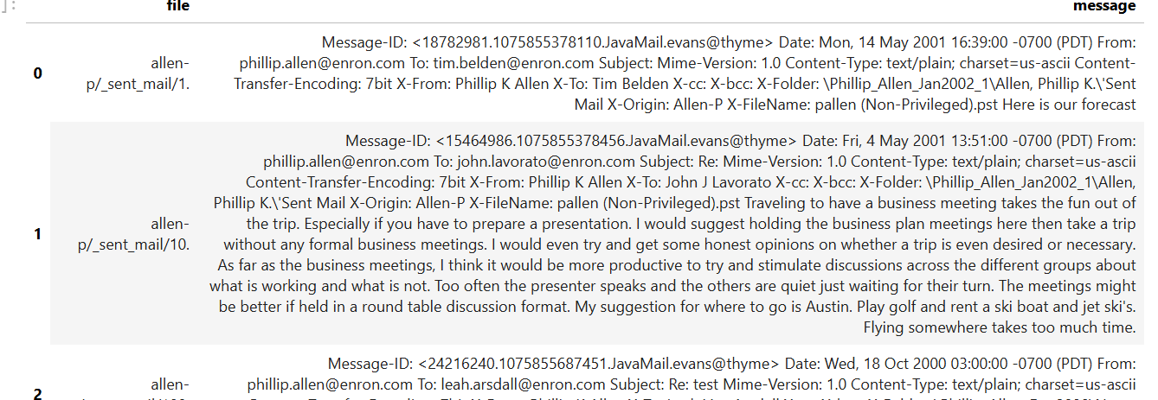
Analysis of the Dataset
The current data set contains the email with the different fields all present as a field in the csv. The different parts of the email needs to be separated out inorder to classify the email

Slide 4
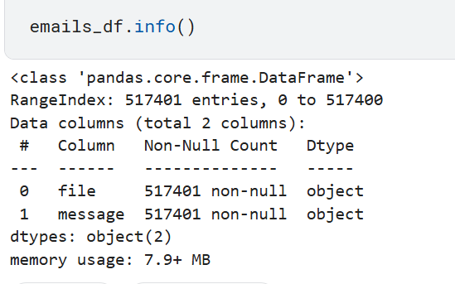
Current dataset
The current dataframe contains a large dataset out of which only a small set will be taken for cleaning and sampling and training.

Slide 5
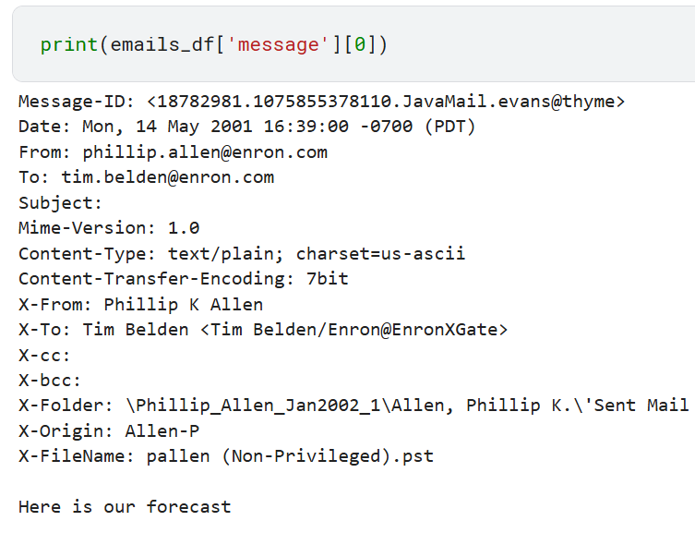
Analysis of the email message
Each part of the message was checked. Out of which the most relevant fields that would be used for the classification model was identified as –
From the header-
From: sender
Folder
Content-Type
To: recipient of the email
Subject
Content of the email ‘Here is our forecast’.

Slide 6
Analysis of the email message
If the sender is from outside the organisation there are higher chances of it being a spam message
If subject line contains “attached is the resume/CV “ it can be classified as a resume (similarly for attachment with resume– currently its not considered)
If Subject line contains application- its an application

Slide 7
Clean the dataset to usable dataset
Sample of current data set is taken
Cleaned data set
The dataset is filtered for each field and a selected few fields are to be used for the training of the data
The cleaned data set is used as a starting point to train a machine learning custom classification model based on document analysis

Slide 8
Further enhancements
The cleaned dataset can be uploaded to a Azure Storage blob container
This can be used as the training data for a custom text classifier
The entities have to be labelled and the sentiment can be analysed.
The model can be trained using Random Forests
The trained dataset can be used against a test dataset to classify the kind of email.
This can be further enhanced using more feedbacks and data.

Slide 9
References:
The Ultimate Guide to the Classification of Emails – Everything You Need to Know – ChatableApps
emailClassification_2024AC (kaggle.com)
The Enron Email Dataset (kaggle.com)
Parse and process Enron emails dataset (kaggle.com)

